Slide 1

Web Scraping
Data Preprocessing
Sentiment Analysis

Slide 2
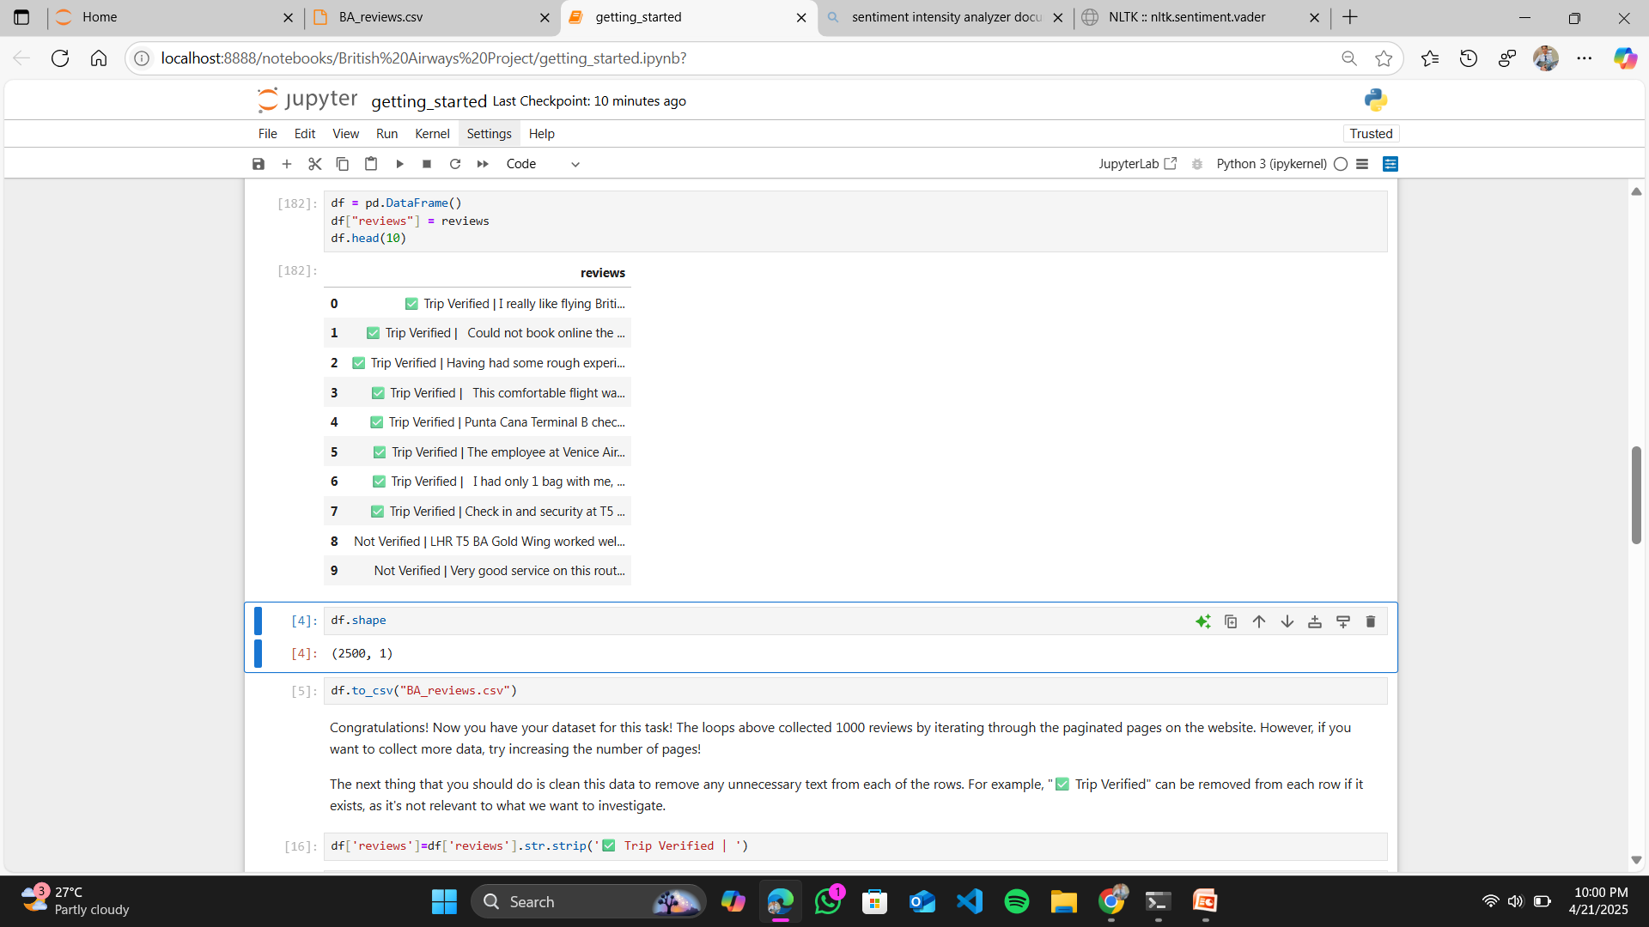
Web Scraping using the beautiful soup library along with the use of the website url from where the data has been scraped

Slide 3
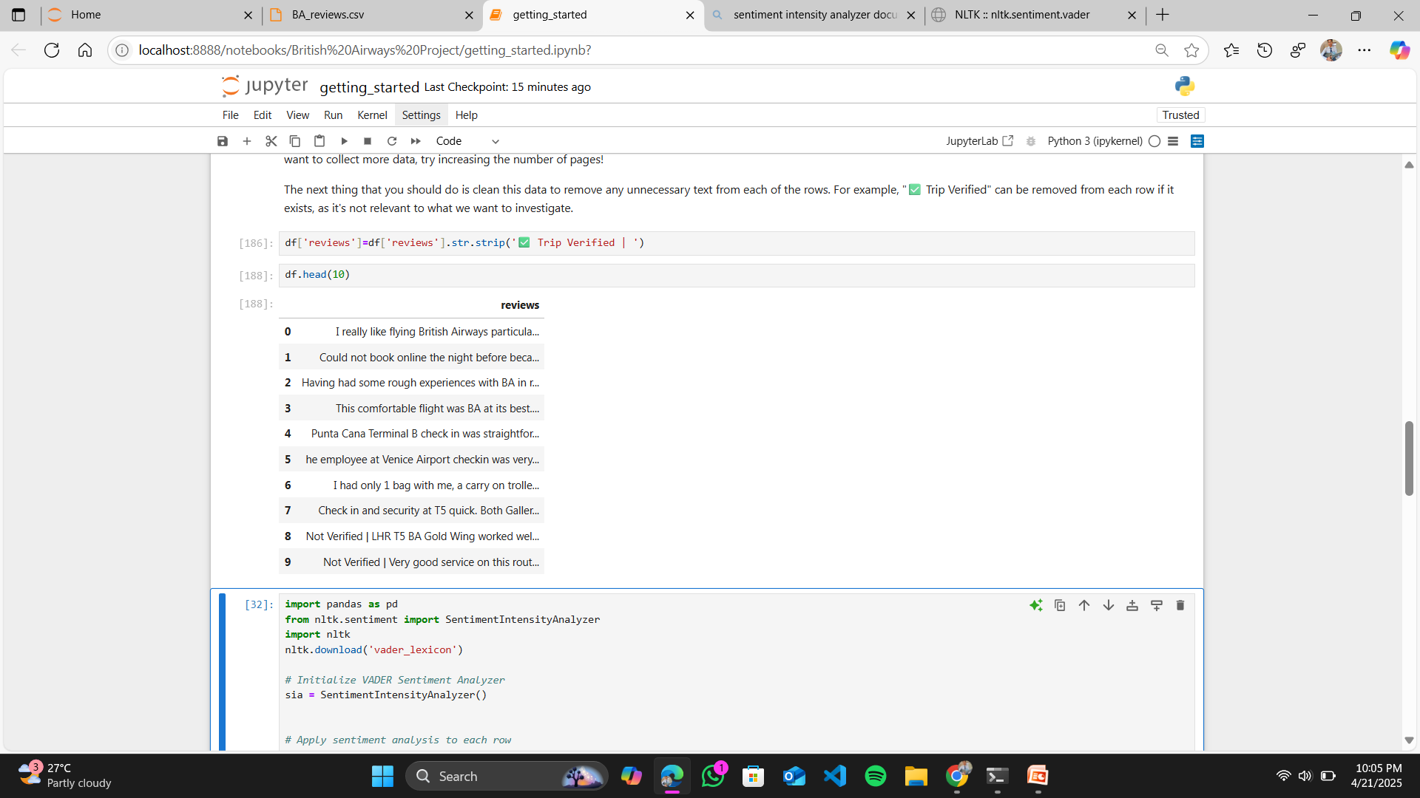
Data Preproceesing include the removal of the irrelevant text from the dataset such as “✅ Trip Verified | ” which allow me to use the relevant data which helped me to analysis the sentiment of the customer.

Slide 4
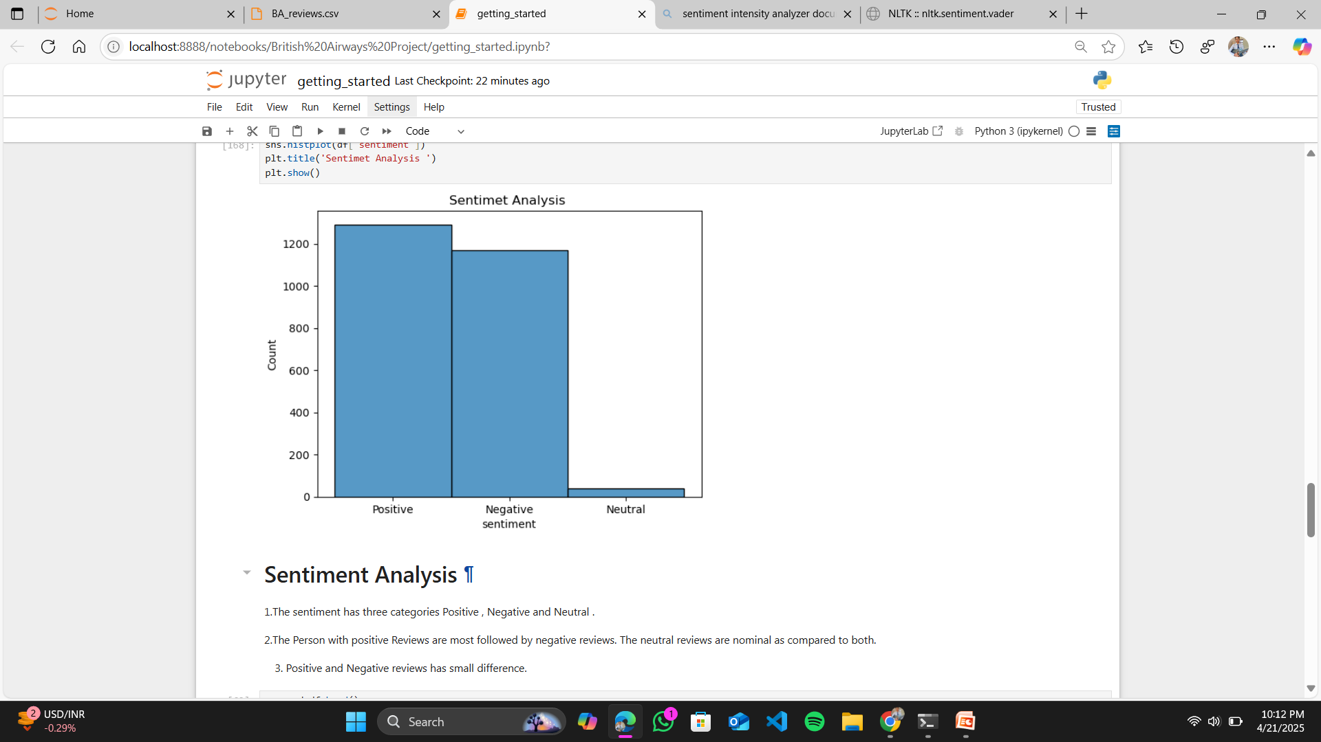
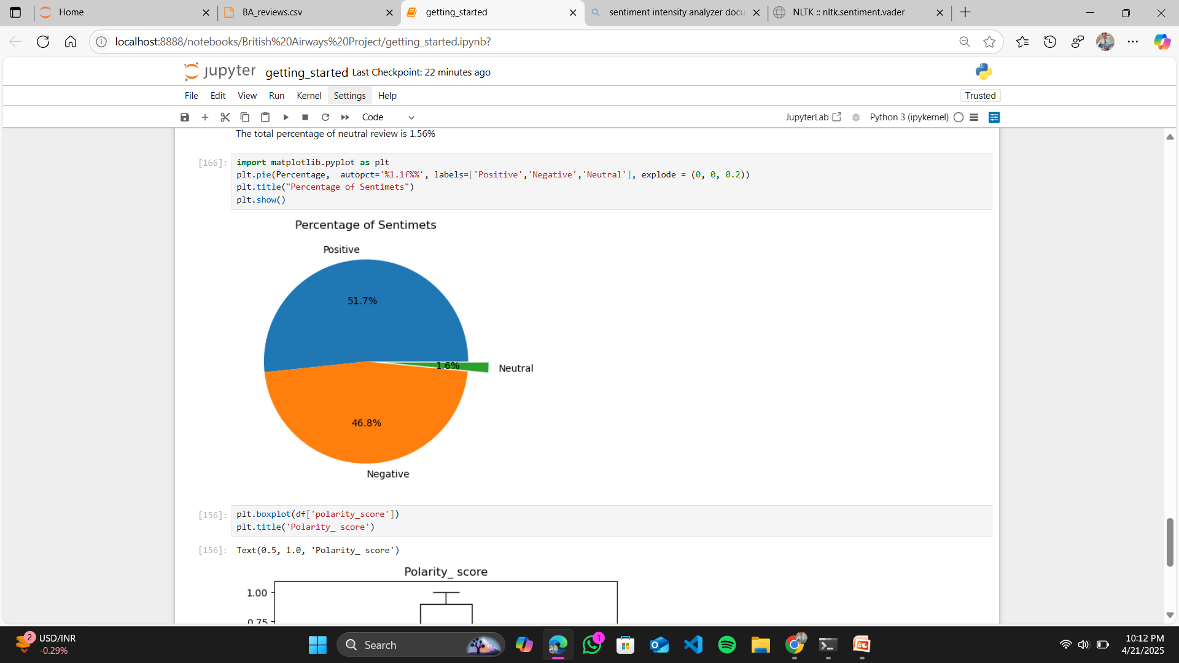
Sentiment Analysis has been done by using the model SentimentIntensityAnalyzer so that we can determine what type of review does the airways has received by the Passenger
We found out three types of sentiment Positive, Negative and Neutral.
Positive Reviews are 1292 with 51.68 % of total reviews.
Negative Reviews are 1169 with 46.76% of total reviews.
Neutral Reviews are 39 with 1.56% of total reviews.

Slide 5
Conclusion
After the Sentiment analysis of the reviews of 2500 people .I found that out of 2500 people 1269 Passengers are satisfied with the service provided by the British Airways whereas 1169 Passengers are dissatisfied by the Airways.However , 39 remains neutral
The percentage of satisfied passengers are 51.68% , dissatisfied passengers are 46.76% and 1.56% are neutral.
The Airways services must be improved so that the satisfaction level of the passengers should be increased for the benefit of the Airways,

